Slide 1
RAINFALL PREDICTION USING MACHINE LEARNING
BY TEAM -
MANDA SUVIDHA REDDY -700729599
ALLAM NEERAJ REDDY - 700729065
AKULA RAHUL SAI GANESH - 700741923
NADAKUDITI SAI TEJA - 700734612

Slide 2
INTRODUCTION
Rainfall prediction is the issue we choose to tackle. The process of teaching a machine to forecast whether it will rain or not given a set of climate features that may effect rain is known as rainfall prediction.
When a machine can anticipate when it will rain, it helps many people and businesses plan their days. It's really difficult to predict when it will rain. It is based on several variables related to the climate, environment, geography, and other things.
Since it depends on a number of variables, predicting rain in machine learning is challenging. In essence, a machine learning algorithm is trained to recognize patterns in the historical time series data and predict whether it will rain or not on a specific day using these patterns.
By enabling farmers to more effectively manage their harvests, historical rainfall data improves the nation's economy. Flooding can be prevented with the use of rain forecasts, protecting people and property. For meteorologists seeking to forecast the weather, the irregularity in the incidence and severity of rainstorms is a challenge. Rainfall prediction is the process of determining whether it will rain or not based on a variety of climate factors.‍

Slide 3
What Machine Learning Plan You have planned To experiment With..?
Rainfall prediction is a classification problem in machine learning where given a set of weather conditions, algorithm predict whether does it rain or not. There are 2 classes/labels namely yes or no (does it rain tomorrow or not).
If someone could be able to know it’s going to rain tomorrow, they can be prepared for that. In addition, It will be of immense value to farmers if we could predict rain
Once data is loaded, Exploratory Data Analysis and pre-processing is performed. Our project aims to use Logistic Regression, Random Forest, Decision Trees and XGBoost algorithms to train. All the models will be compared against each other in terms of accuracy and training time. Scikit-learn module is used to implement algorithms and tune the parameters.

Slide 4
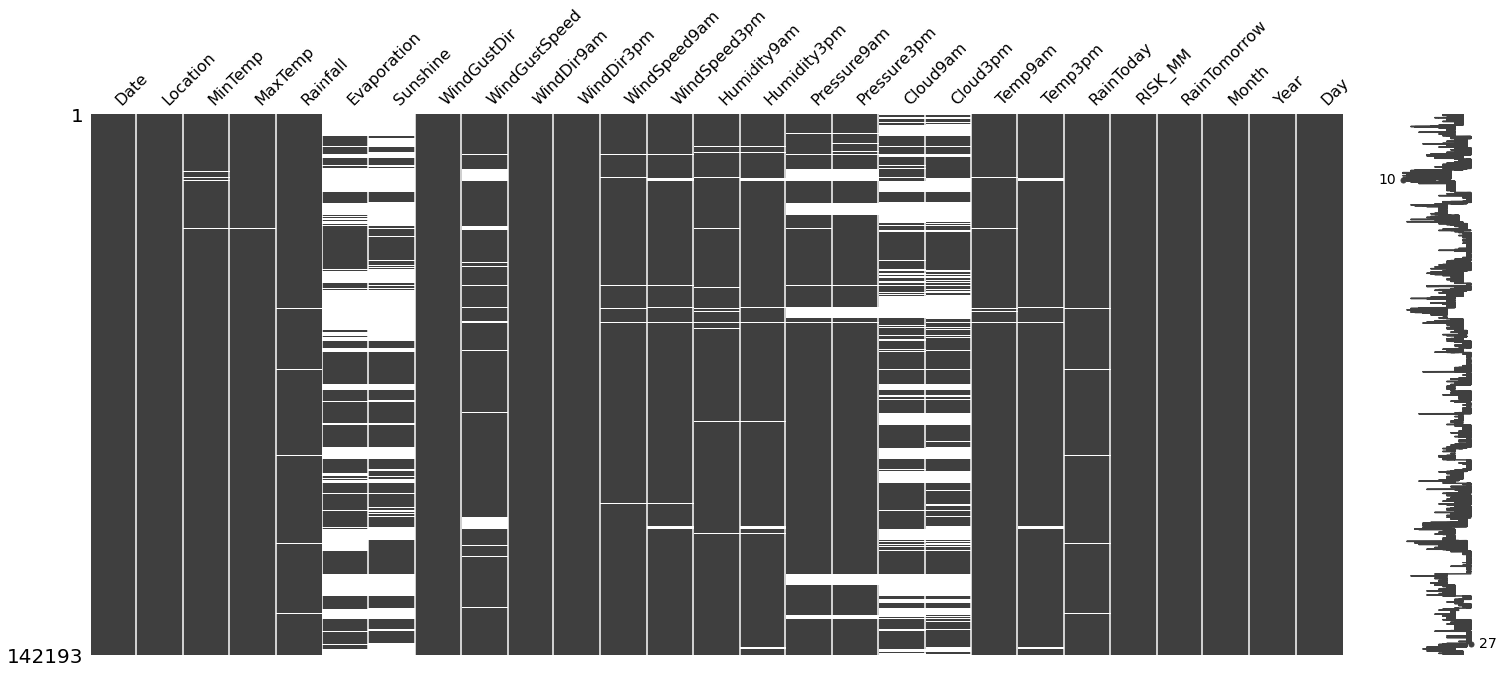
Data Loading and Exploratory Data Analysis-
The act of copying and loading data into a database from a source file, folder, or program is known as data loading.Data analysts employ data visualization and statistical tools to characterize dataset characterizations, such as size, amount, and correctness, in order to better understand the nature of the data. This is known as data exploration.‍

Slide 5
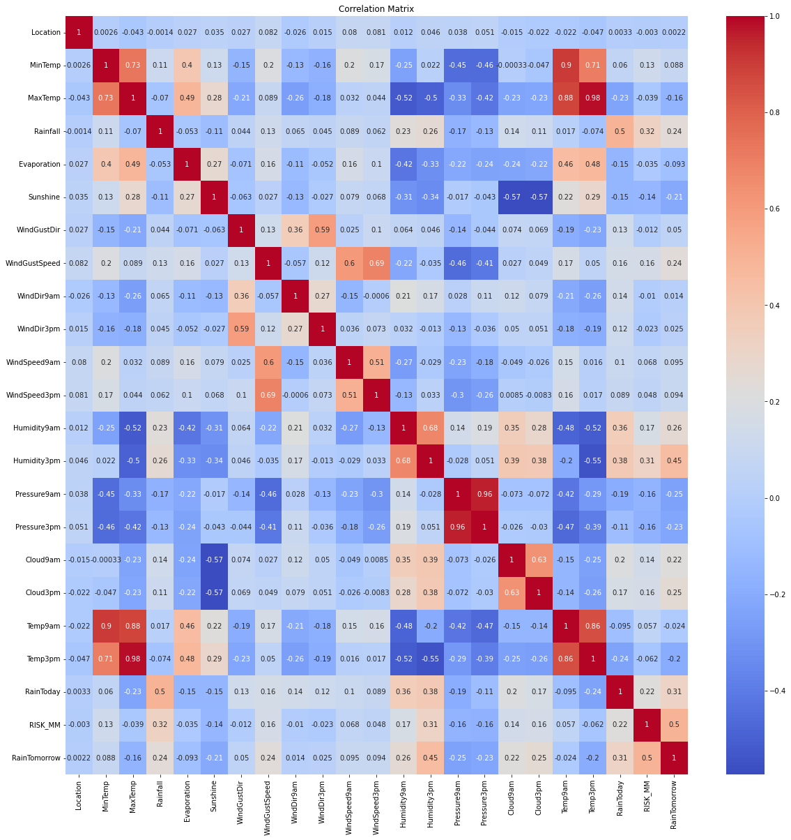

Slide 6
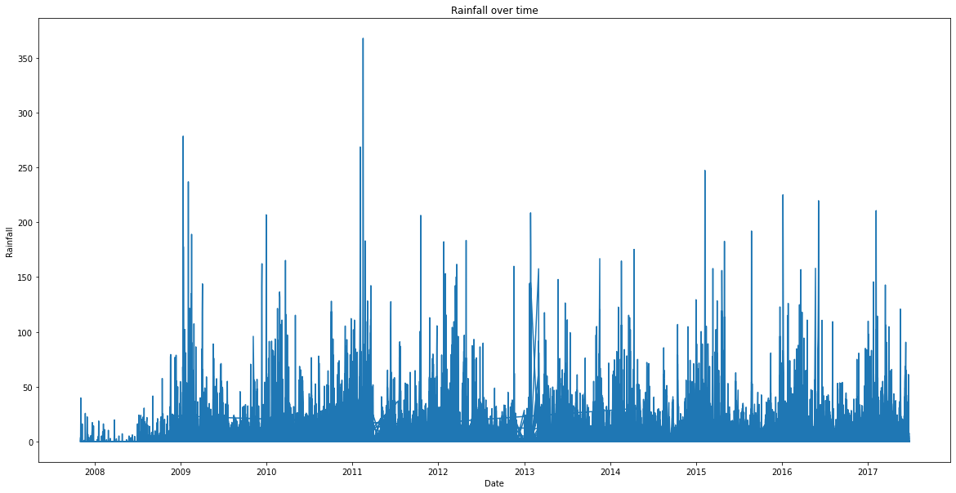
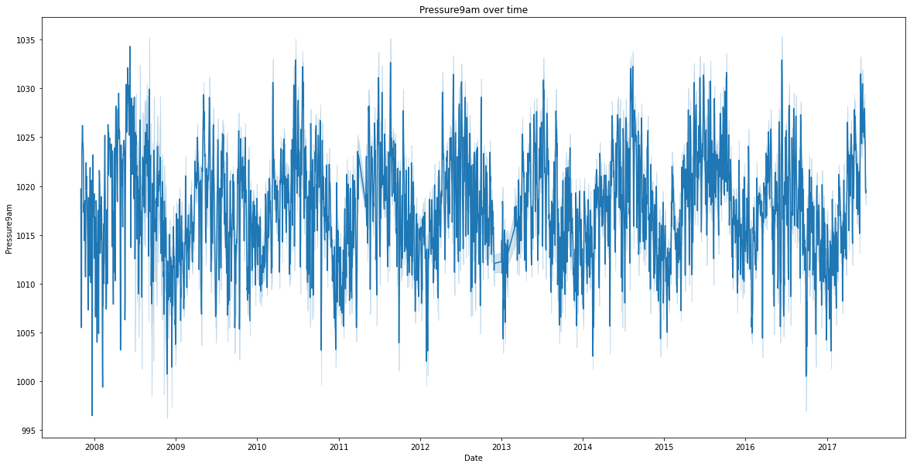
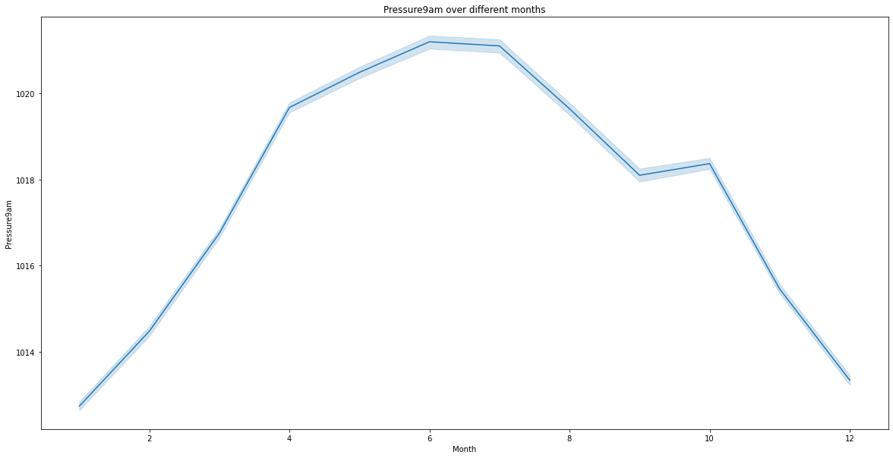
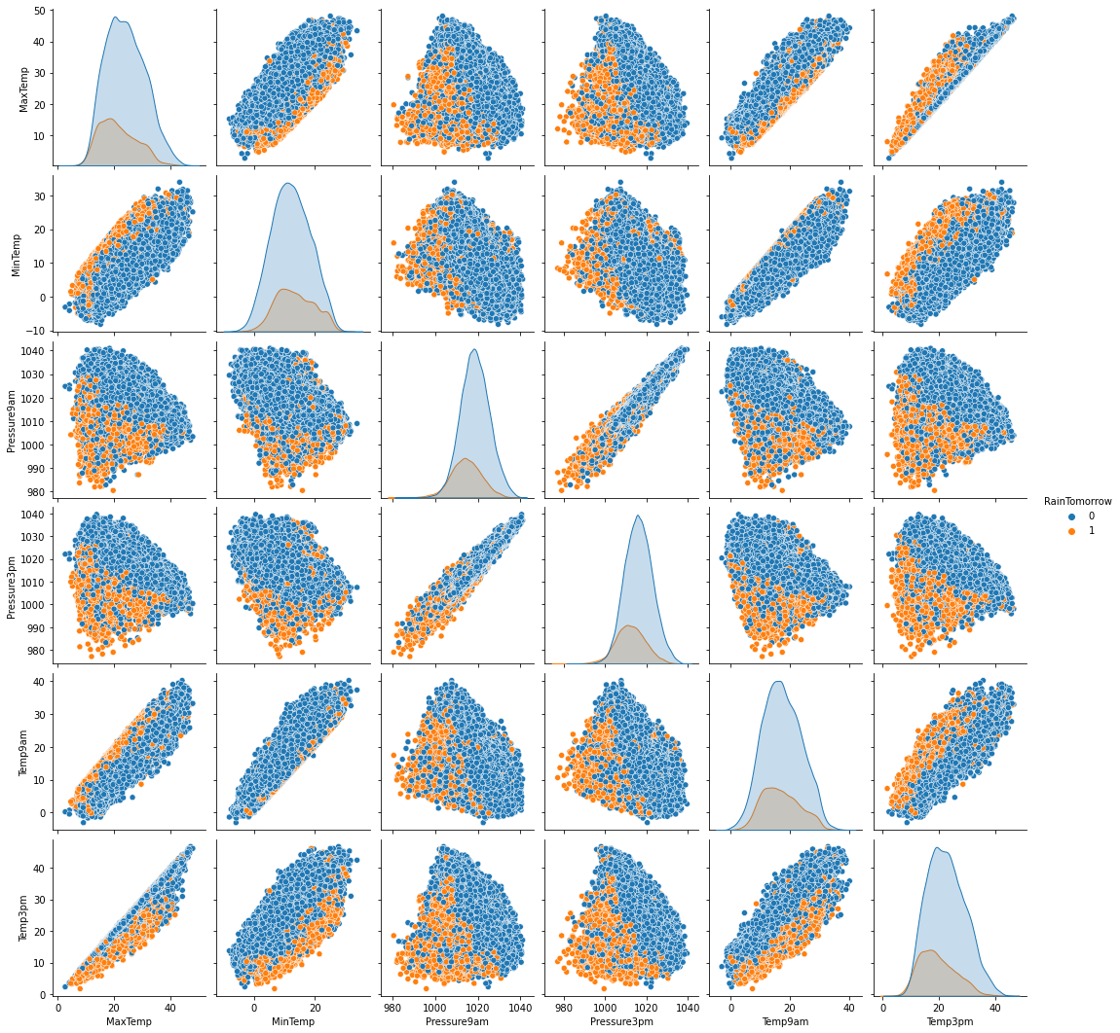

Slide 7
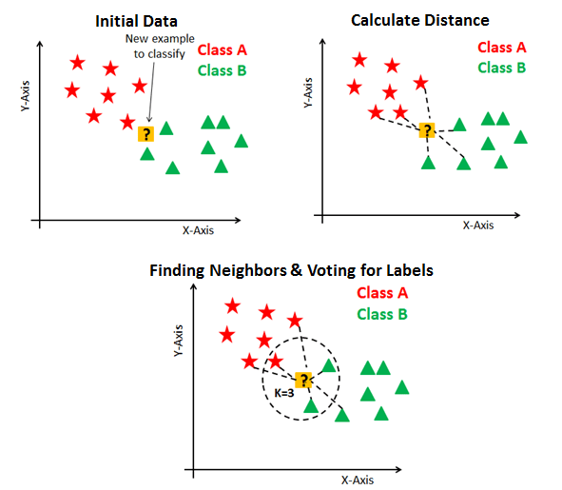
DATA PRE-PROCESSING - Data preprocessing, which is a crucial phase in the data mining process, can be defined as the altering or dropping of data before to usage in order to ensure or optimize performance. Projects involving data mining and machine learning are particularly susceptible to the adage "garbage in, garbage out."‍
Model Training –
1. K Nearest Neighbour Classifier ‍:

Slide 8

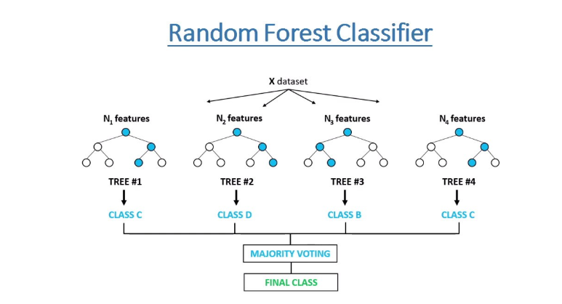
Decision Tree Classifier:
Random Forest Classifier:

Slide 9
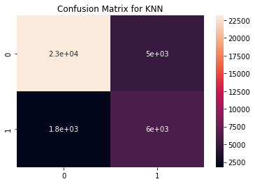
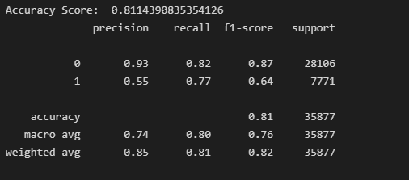
Results and Experimentation:
K Nearest Neighbour Classifier:

Slide 10
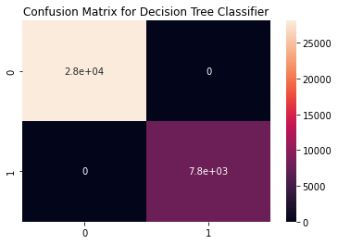
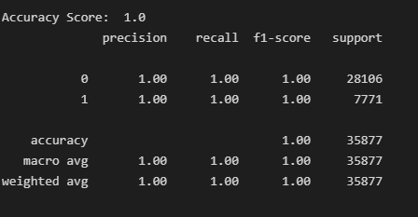
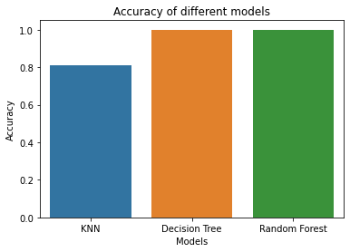
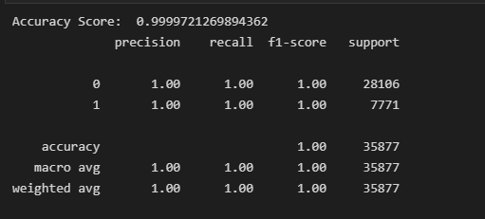
Decision Tree Classifier:
Random Forest Classifier:

Slide 11
Further developments that can be implemented
Applications receive live stream data to provide more accurate results and weather forecasts.‍
More precise forecasts of wind, pressure, and temperature changes on a smaller scale have been made possible by the National Weather Service's capacity to create and manage more complicated weather computer models.‍
In the past, computer models were not sophisticated enough to account for the effects of heating and moistening from lakes. It appeared as though there were no lakes at all! With the help of modern computer models, meteorologists can make more accurate predictions.‍

Slide 12
CONCLUDE
Weather warnings are crucial forecasts because they serve to safeguard property and human life. For traders in the commodity markets, forecasts based on temperature and precipitation are crucial for agriculture. Utility companies use temperature projections to predict demand for the upcoming days.‍

Slide 13
THANK YOU

